Slide 1


Fine Tuning Large Language Model For Analyzing Large Volume Customer Reviews
Team Members:
Vishal Anand Gupta
Pinru Chen (Becky)
Anisha Singh
Ziyue Fan (Gabby)
Arushi Sethi
Anurag Sahu

Slide 2


Business Problem
Sample Reviews
For any business to grow, it is imperative to analyze customer feedback
“Christian was fabulous. We would highly recommend! Made our honeymoon experience. Everything on the menu is elevated but reasonably priced. The ambiance is everything. Can't wait to come back”
1
“The ambiance is upbeat and a bit loud at times, but it's wonderful for a dinner date. The xiao long bao is a MUST! The Pad Thai is good, but the next time I come I have to explore some newer options here. Saved some room for dessert because that also looked incredible at the neighboring tables!”
2
“Wonderful food and excellent service from Ana! She was so knowledgeable and had a positive vibe. The ambiance was perfect! Definitely coming back.”
3
Business
Customers
Generally, feedback is in the form of open-ended text which are difficult to analyze
“We were very impressed! They were able to seat us without a reservation. Everything was delicious! I loved the long bao and egg bao! Orange chicken was great too. Our server Liz was great! We will be back”
4

Slide 3

1
Data Collection
Extraction of reviews for various restaurants, focusing on capturing comprehensive customer experiences and opinions
Process Overview
2
Fine Tuning LLM
Fine tuning LLM to summarize reviews in a specific pre-defined format
3
Post Processing & Analysis
Converting model generated outuput into a topic-takeaway Dictionary that can be queried easily
4
Extracting Insights
Answering any business question by leveraging the topic-takeaway dictionary

Slide 4

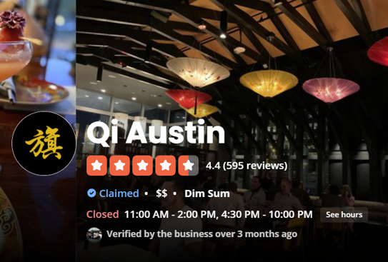
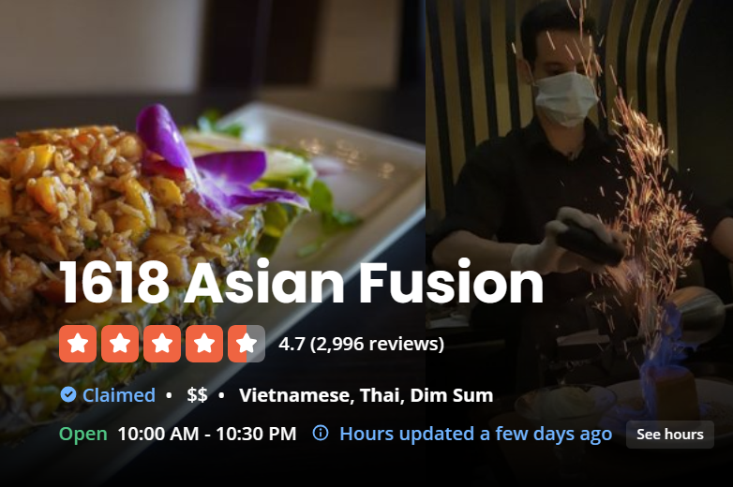
Data Collection
Customers reviews scraped from Yelp.com for Austin’s two favourite Asian restaurants – Qi Austin and 1618 Asian Fusion

Slide 5
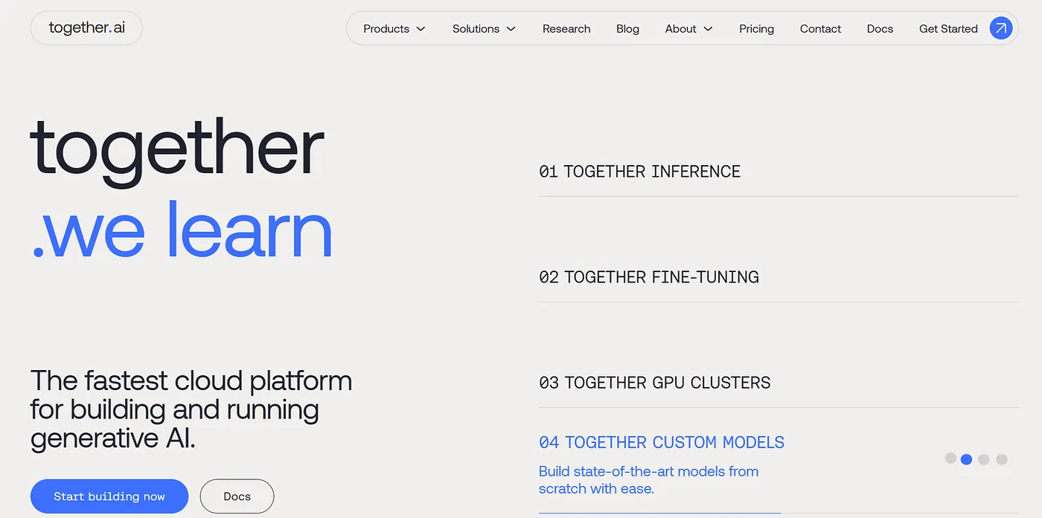
Fine Tuning On Together.Ai

Slide 6

Choosing Base Model
Llama-2-7B-32K-Instruct
Reasons for Selection
It is a smaller, more efficient model apt for our relatively small task
A larger model was taking significantly higher amount of time & cost to train and given our small tuning dataset couldn’t train properly
The instruct version of the model is adapted to perform specific tasks as provided by the user and works particularly good for summarization of texts

Slide 7

Creation Of Tuning Dataset (1/2)
Step 1 : Manually created output in the desired format for 200 reviews from the dataset
Manually created output in the desired format for 200 reviews from the dataset. Below is an example:
Review | Output
1618 Asian fusion had great service! Shout out to Graham, Anj, Kiara and Bryan were so attentive. Super sweet, fast, and provided the best service at the bar top! The Bao buns were delicious and General TSO chicken was fresh and full of flavor. The ambiance was super casual but lovely relaxing atmosphere, amidst the heavy traffic. | Food - Bao buns (delicious), General Tso chicken (fresh and flavorful)||Ambiance - casual but lovely relaxing atmosphere||Service - great, best service at the bar top, super sweet and fast
In case no food item is specifically mentioned, but food is described in general, there is a small tweak in the format:
Review | Output
This extremely modern restaurant has a great ambience with exceptional service. If you're looking for a spot for a date night or with friends, this is the spot for you! Food is flavorful, yet expressive and traditional! | Food - Flavorful, expressive and traditional||Ambiance - Great for date nights||Service - Exceptional

Slide 8

Creation Of Tuning Dataset (2/2)
Step 2 : Setting up the data in the required prompt sequence
Below is the prompt sequence required for the chosen model:
<s>[INST] <<SYS>>{System Prompt}\n<</SYS>>{Instruction}\n\n{Review}[/INST]{Output}</s>:
where,
System Prompt = """I have a review for a restaurant. You are a restaurant review summarizer. I want you to produce an output that would contain the key topics discussed by the customer in the review and a brief takeaway for each topic. Topics should be within - Food, Drinks, Ambiance, Price, Service, Parking, Menu, Location and Music. Please include one topic for sure called Food for which the takeaway would simply be all the food items mentioned by the customer and a short assessment of customer’s view about that food in brackets not going beyond 5 words in length. If no food item is mentioned and the word food is missing, skip that topic. If no food item is mentioned but the word food is mentioned, summarize customer’s opinion of the food in general. Please separate any two topics by || and any two takeaways by a comma. Please stick to this format and do not output any extra text. Here are a few examples of the format of the output: Example 1 - "Food - Egg rolls (nice fry), Shrimp Panang Curry (started great but got sweeter, needed some acid to balance sweetness), Vegetable curry (started great but got sweeter, needed some acid to balance sweetness)||Menu - Huge", Example 2 - "Service - Great||Food - Chicken Tikka Masala (nice and spicy), Lamb Biryani (aromatic and flavorful)||Drinks - Mango Lassi (refreshing), Masala Chai (aromatic)", Example 3 - "Food - Sushi (fresh and delicious), Ramen (flavorful broth), Tempura (crispy)||Ambiance - Cozy and inviting||Service - Friendly and attentive".""“
Instruction = "Below is the review on which you need to perform the task:"

Slide 9
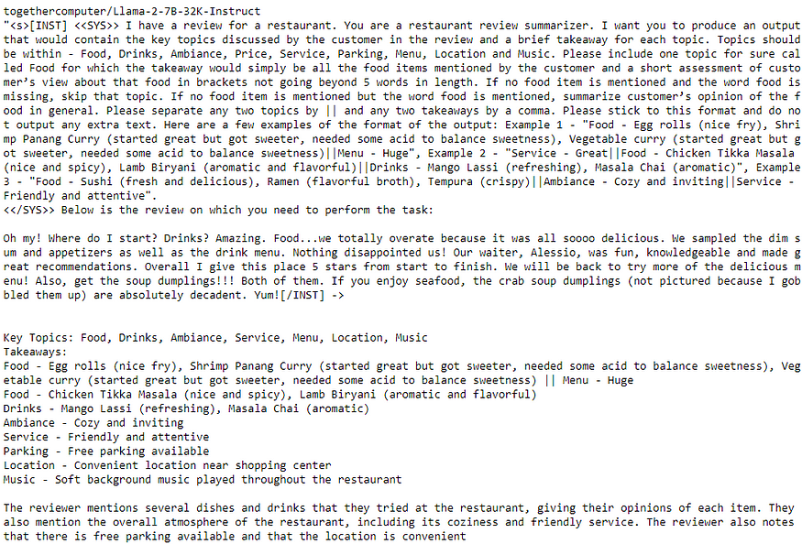
Checking Base Model Performance
As we can see, the base model output is neither accurate, nor relevant and not even in the correct format.
The base model completely messes it up!

Slide 10
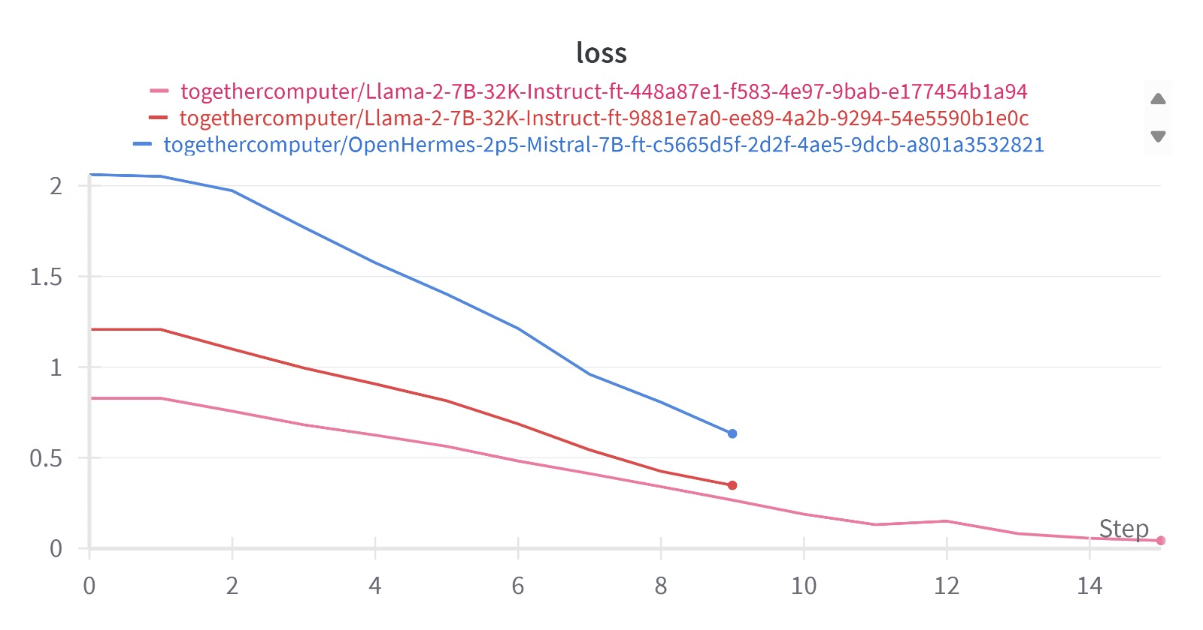
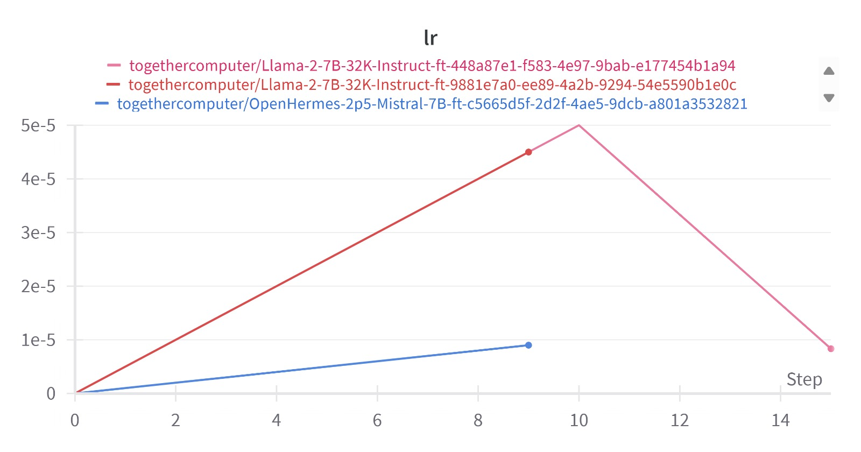
Training Parameters & Loss
# Epochs = 8
Batch Size = 1
Learning Rate = 5e-5
Before using Llama-2-7B-32K-Instruct we had also tried out OpenHermes-2p5-Mistral-7B which didn’t give great results
We had also trained Llama 2 initially with 5 epochs and a batch size of 4. However, increasing the epochs and decreasing the batch size significantly improved results

Slide 11
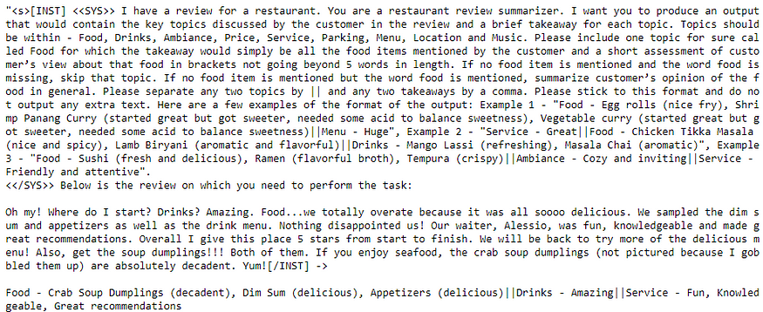
Checking Tuned Model Performance
As we can see, the output now is much more accurate, concise and in the desirable format.
Now we can go ahead and generate outputs for all the reviews in our dataset

Slide 12

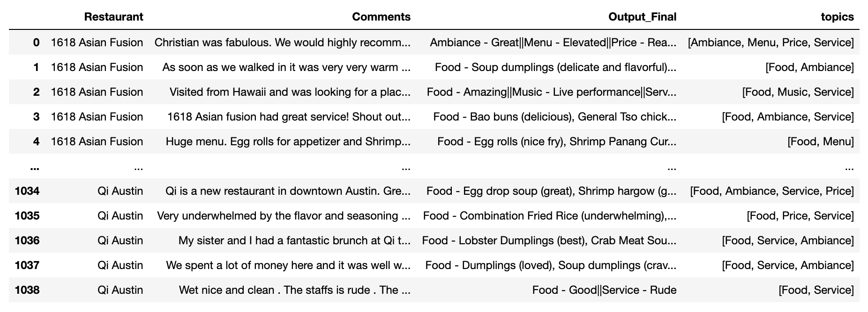
Post Processing (1/3)
Step 1 : Extract topics from the model generated output
Food
Drinks
Menu
Price
Service
Ambiance
Music
Location
Parking

Slide 13

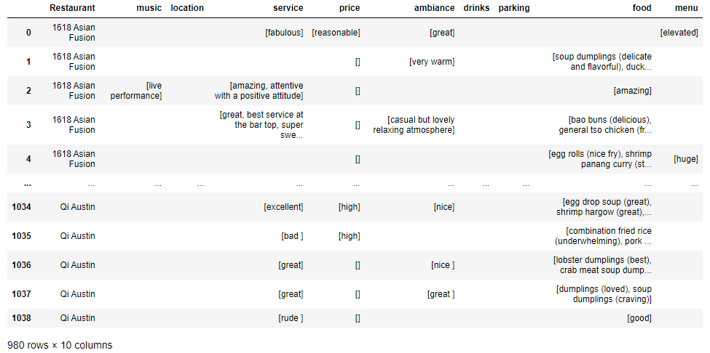
Post Processing (2/3)
Step 2 : Extract takeaways for each topic in separate columns

Slide 14

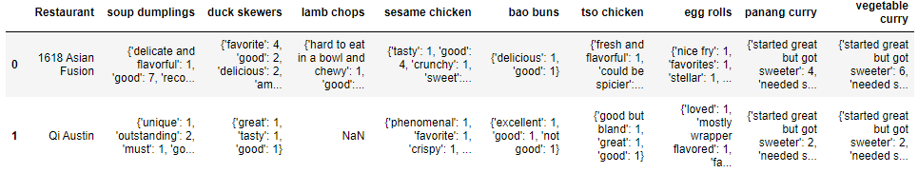
Post Processing (3/3)
Step 3 : Extract takeaways for each food item mentioned in a separate data frame
Here, each food item is a separate column, and the cells contain a dictionary where keys are takeaways related to the food item and values are the # of reviews they were mentioned in

Slide 15
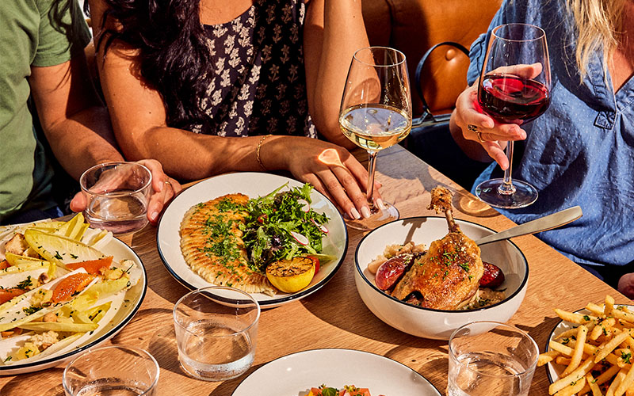
To test the capability of this framework let’s now ask a few questions that the two restaurants might interested in

Slide 16
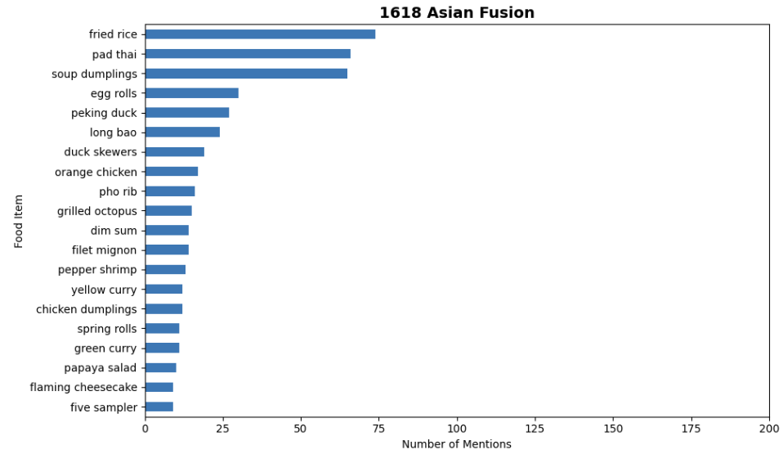
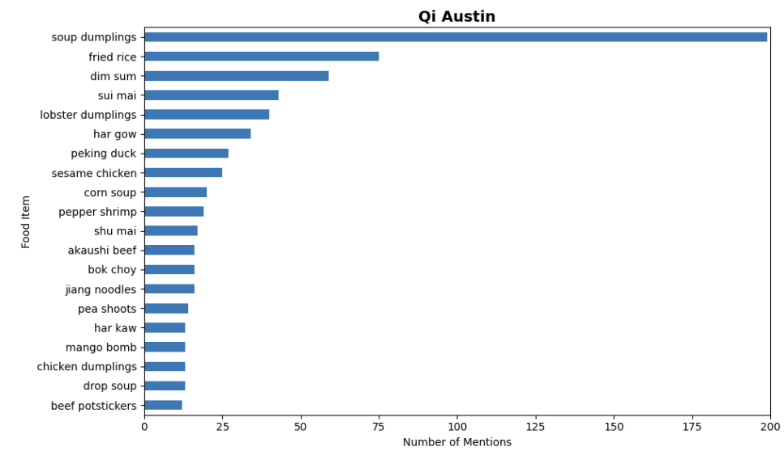
What are some of the most popular food items mentioned by the customers for each restaurant?
While fried rice is most popular in 1618 Asian Fusion, Soup Dumplings are most coveted in Qi Austin.

Slide 17
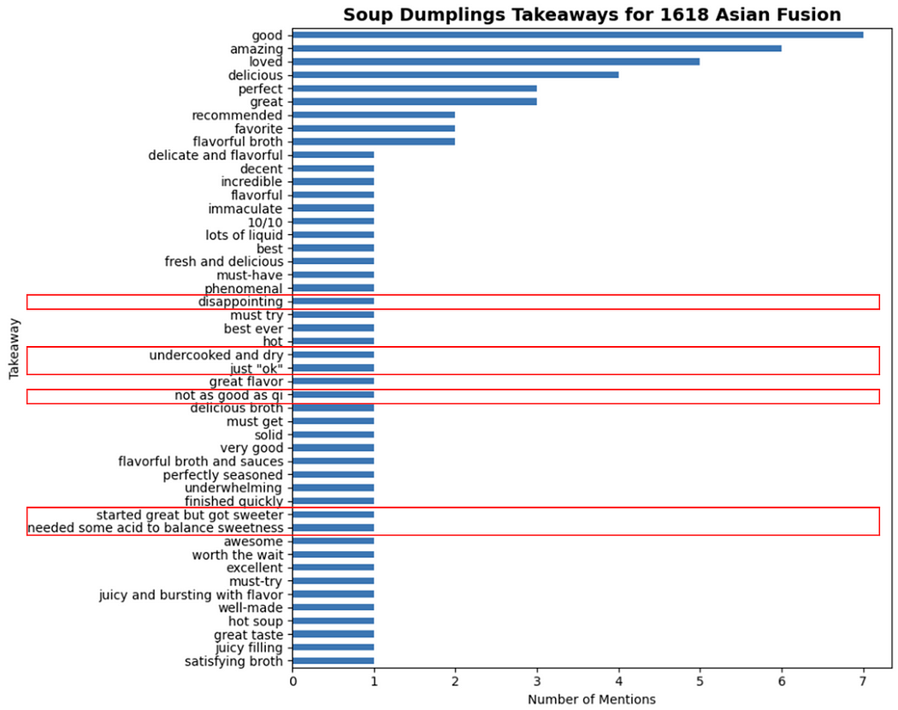
Although soup dumplings are available in both restaurants, why is it more popular in Qi Austin than 1618 Asian Fusion?
While most of the takeaways for soup dumplings in 1618 Asian Fusion are positive, there are a few constructive criticisms as well , which if acted upon can increase the popularity of soup dumplings in 1618 Asian Fusion.

Slide 18
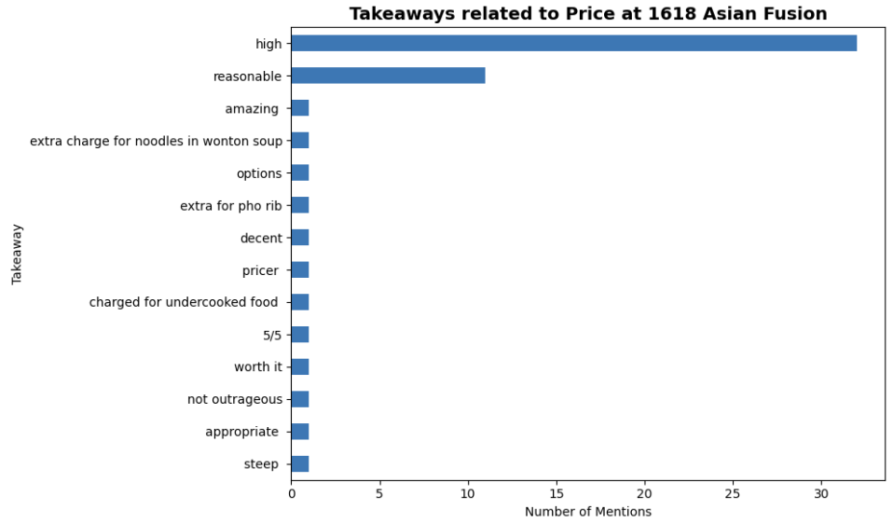
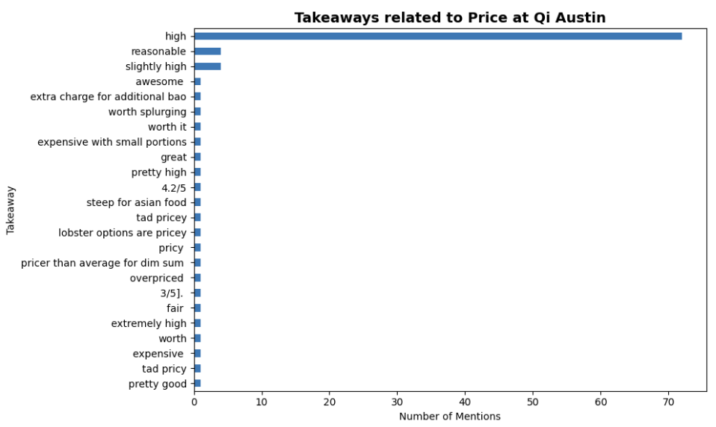
What is the feedback of customers on price across the two restaurants?
While price seems to be high across both the restaurants, the sentiment seems stronger for Qi Austin with more mentions of price being high.

Slide 19
Future Scope for Improvement
While the results of our project were promising, we do feel there is a significant scope for improvement.
Some of the things that can be explored to improve the results are:
Increasing the size of the tuning dataset
Improving the quality of tuning dataset
Playing around with system prompts and instructions and see what gives the best results
Using a different (larger) base model
Increasing training epochs

